Slide 1
Machine Learning in Practice I
Lecture 8
Antal Jakovac, 2025

Slide 2
Regression

Slide 3


Regression
Regression is optimization in a continuous parameter space
Data model → feature optimization:
  we need a parametric combination of the original variables
  optimize with respect to some condition (c.f. SVM)
Continuous value estimation:
  the task can be to predict a continuous variable
  classification can be based on probability distribution

Slide 4
Regression
task of regression
we have data pairs (X, Y) → database
we are looking for a model that
  we can not consider all possible functions (too large space)
  fix a functional space (e.g. polynomials, Gaussians, etc.):
  the variables omega select the actual function

Slide 5
Regression
task of regression
there is no perfect model! → philosophical problem …
  not enough observation (data)
  data do not contain all information
  functional space does not cover all possible effects
consequence: can not be satisfied
what can be achieved: best representation, where the error is the smallest → what is “best”, and what is “error”?

Slide 6
Regression
task of regression – theoretical approach
not enough information: x→y relation is not unique
there is a probability to measure a (data, label) pair:
for the complete dataset, assuming independent measurements
for a given input there can be a lot of outputs: conditional probability (instead of a function)

Slide 7
Regression
task of regression – theoretical approach
data model:
what is the best parameter choice? → ensemble of worlds
define the “distribution of the parameters” using Bayes theorem
as the function of the parameter → likelihood function
(assuming no restriction to possible parameter values)

Slide 8
Regression
task of regression – theoretical approach
best parameter value when is maximal (maximum likelihood):
confidence levels: → hypersurfaces
a confidence level can be characterized with the probability to be inside the volume
  for example: the probability that is 95% (according to )

Slide 9
Regression
task of regression – theoretical approach
in practice we use Gaussian (central limit theorem)
  assume that data points in the database are independent
  data model gives the expected value
  with unit correlation matrix → least square method (LSM)
the likelihood → not Gaussian (except linear model)

Slide 10
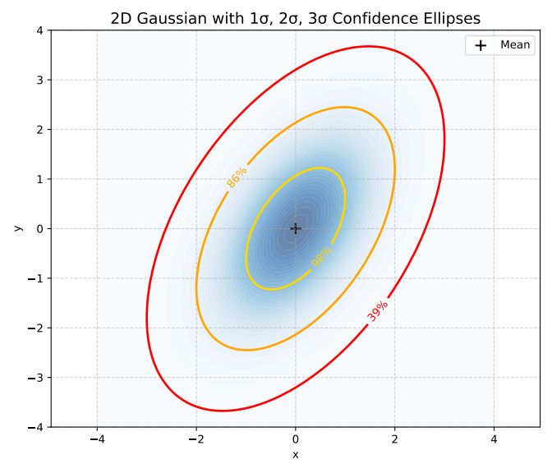
Regression
task of regression – theoretical approach
expanding near the maximum likelihood → Gaussian with
Gaussian confidence levels
  the confidence surfaces are ellipsoids:
  confidence levels in one dimension
sigma-level | 1 | 2 | 3 | 4 | 5
confidence | 68.27% | 99.54% | 99.73% | 99.9937% | 99.99994%

Slide 11
Regression
task of regression – theoretical approach
Gaussian confidence levels and chi-squared distribution
probability to be inside with the incomplete Gamma function
in Python: scipy.special.gammaincc

Slide 12

Regression
task of regression – theoretical approach
calculation with Gaussian distribution: practical rules
  assume y is Gaussian
  introduce zero-mean variables
  expected values:
  higher expected values are product of pairs!
  e.g.:

Slide 13
Regression
task of regression – theoretical approach
hypothesis checking with chi-squared distribution:
  assume Gaussian hypothesis and the data model are correct
  treat the labels as independent random variables
  compute expected value of chi-squared
chi-squared value over degrees of freedom is one

Slide 14
Regression
Linear regression

Slide 15
Linear regression
simplest relation: linear function
data are
assume linear relation:
coefficient a is an matrix, b is a vector
task to find the value (distribution or likelihood) of the coefficients
simplest case, in lot of cases very powerful

Slide 16
Linear regression
one-dimensional case
simplest: 1D linear regression, diagonal correlation matrix
problem: data and labels are real numbers
assume there is a linear relation between the two:
chi-squared function
likelihood is Gaussian in a,b:

Slide 17
Linear regression
1D linear case
computation: introduce new notations
  sum of inverse variances:
  averaging:
  correlation:

Slide 18
Linear regression
1D linear case
computation:
  and are independent Gaussian variables
  the distribution of the variable y=ax+b (with fixed x) is also Gaussian

Slide 19
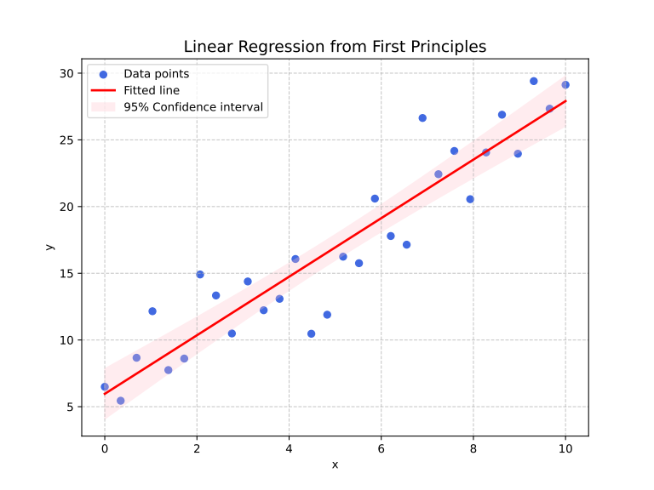
Linear regression
1D linear case
interpretation:
  best slope value and variance
  chi-squared expected value

Slide 20
Linear regression
higher dimensional linear case
data are
assume linear relation:
coefficient a is an matrix, b is a vector
calculation and formulae remain the same

Slide 21
Linear regression
higher dimensional linear case
example:
then the result is
# linear regression in 2D
Ndata = 100
a = np.array([[1, 2],[3, 4]])
b = np.array([1,-1])
x = np.random.uniform(0,1, size=(2, Ndata))
noise = np.random.normal(0,0.1, size=(2, Ndata))
y = a@x + noise + b[:,None]
barx = np.mean(x, axis=1)
bary = np.mean(y, axis=1)
Cxx = (x-barx[:,None])@(x-barx[:,None]).T/2
Cyx = (y-bary[:,None])@(x-barx[:,None]).T/2
a1 = Cyx@np.linalg.inv(Cxx)
b1 = bary - a1@barx
omega1, b1

Slide 22
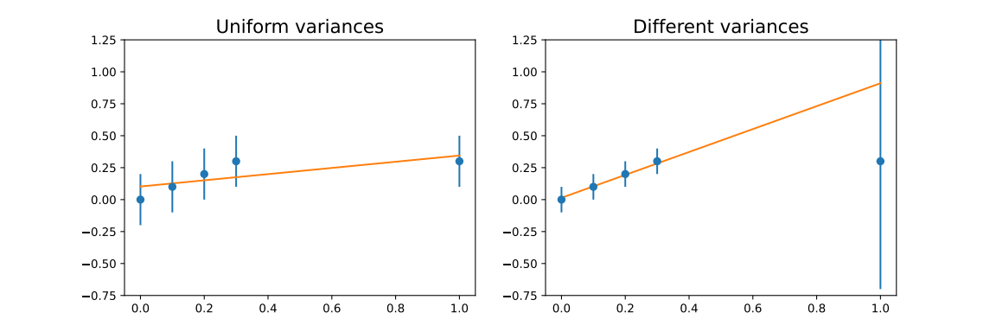
Linear regression
role of the individual variances
effect of different variances → weight importance of points
variance
  measurement (tedious)
  theoretical considerations (e.g. relative error is )
  user expectations (e.g. some points are important)

Slide 23
Linear regression
role of the individual variances
correlation matrix from measurements:
  assume that the data are i.i.d. normal
  distribution of is normal with → estimate for mean
  mean of → → variance

Slide 24
END OF LECTURE 8

